Slide 1
Chapter 4: Drainage Systems and Water Resource of Ethiopia and the Horn
Drainage Systems and Water Resource of Ethiopia and the Horn
Introduction
Major Drainage System of Ethiopia
Water Resources: Rivers, Lakes and Sub-Surface Water
The Ethiopian Rivers
The Ethiopian Lakes
Subsurface (Ground) Water Resource of Ethiopia
Water Resources Potentials and Development in Ethiopia

Slide 2
Introduction
Of the earth’s total water surface
Nearly 97.5% is alkaline accumulated in seas and oceans.
The remaining 2.5% is fresh water, of which nearly
68.7% is deposited in glaciers
30.1% in ground water
0.8% in permafrost and
0.4% in surface waters.
Water in lakes, rivers, atmosphere, soils and wetlands are considered as surface waters.
Surface and ground waters are by far the most abundant and easily available fresh waters.

Slide 3
The factors that made the country to have larger volume of ground and surface water are:
The diverse topographical setup
relatively higher rainfall and
its nearness to equator.
Around 0.7% of the total landmass of Ethiopia is covered by water bodies.
The country’s surface water potential is estimated to be 124.4 billion cubic meters (BCM).
Consequently, many call Ethiopia, the water tower of “Eastern Africa”.

Slide 4
Major Drainage System of Ethiopia
The flow of water through well-defined channel is known as drainage.
A drainage system is made up of a principal river and its tributaries (the rivers that flow into it).
Therefore, a drainage system is branched network of stream channels together with the adjacent land slopes they drain.
The drainage pattern of an area is the outcome of the geological processes, nature and structure of rocks, topography, amount and the periodicity of the flow.
A drainage basin is the topographic region from which a river and its tributaries collect both the surface runoff and subsurface flow.

Slide 5
The general patterns of major river basins in Ethiopia are determined by topographical structures which can be clarified as:
The topography of the outward sloping of the Western and South eastern plateaus
The structural formation of the Rift Valley with its in-ward-sloping escarpments resulting mainly in an inland drainage system.
Faults and joints that structurally influence part of the courses of many rivers.
Following the complex physiographic setup and geological makeup, Ethiopia possesses three broadly classified drainage systems namely
Western Drainage Systems,
Southeastern Drainage Systems and
Rift Valley Drainage Systems.

Slide 6
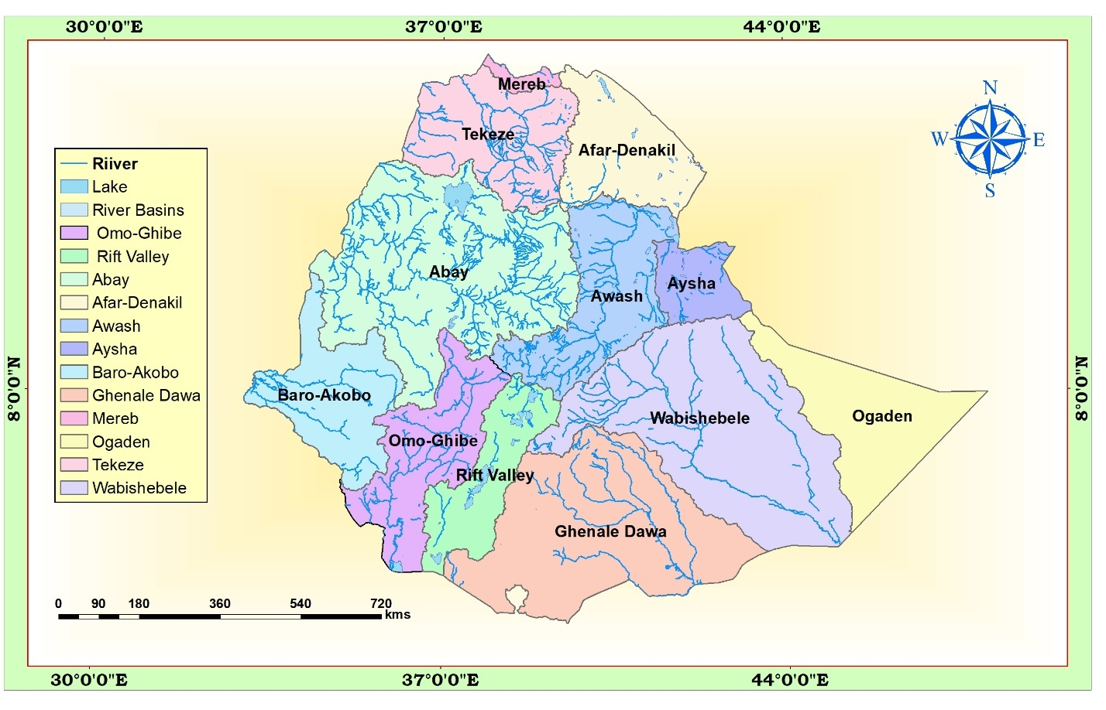
.

Slide 7
The Western Drainage Systems
The Western Drainage Systems are:
the largest of all drainage systems
drains 40 percent of the total area of the country
carry 60 percent of the annual water flow
Most of the catchment area coextends with the westward sloping part of the western highlands and western lowlands.
This drainage system comprises four major river basins namely
the Tekeze, Abay, Baro-Akobo, Ghibe (Omo).
Unlike other river basins in the system, the Ghibe (Omo) flows southward.
The Abay, Tekeze and Baro flow westward ultimately joining the Nile which finally ends at Mediterranean Sea.

Slide 8
Abay river basin
The largest river both in volumetric discharge and coverage in the western drainage systems
covers an area of 199,812 km², covering parts of Amhara, Oromia and Benishangul-Gumuz regional states.
carries 65 percent of the annual water flow of the region.
rises from Lake Tana (some sources indicate its origin from Sekela, Choke mountain)
flows about 1,450 kilometres and joins the White Nile in Khartoum, Sudan to form the Nile River.
More than 60 streams drain the Abay within elevation ranging between 500 - 4261 meters above sea level.
The largest of these is Ghilgel Abay (Little Abay).
flows eastward, turns 180° to make a large bend and after cutting an impressive and deep gorge emerges out in the west.

Slide 9
Tekeze river
Tekeze and its tributaries carry 12 percent of the annual water flow of the region
Drains 82,350 Km2 of land surface within elevation ranging between 536-4517 meters above sea level.
Erosion in the basin resulted in large tablelands, plateau blocks and isolated mountain groups.
The basin has two main tributaries (Angereb and Goang) which rises in the central highlands of Ethiopia.
Tekeze River is termed Atbara in Sudan, which is a tributary of the Nile.
The total mean annual flow from the basin is estimated to be 8.2 billion metric cubes (BMC, here after).

Slide 10
Baro-Akobo and Ghibe/Omo rivers
The Baro-Akobo and Ghibe/Omo rivers drain the wettest highlands in the south and southwestern Ethiopia.
Baro-Akobo carry 17 percent and Ghibe/Omo 6 percent of the annual water flow.
The Ghibe/Omo river basin drains an area of 79,000 km2 with an estimated mean annual flow of 16.6 BMC.
In the lower course, the Baro River flows across an extensive marshy land.
Baro Akobo river basin has an area of 75,912 km2, covering parts of the Benishangul-Gumuz, Gambella, Oromia, and SNNPR.
The total mean annual flow from the river basin is estimated to be 23.6 BMC.
The Baro together with Akobo forms the Sobat River in South Sudan.
The Ghibe/Omo River finally empties into the Chew-Bahir at the mouth of Lake Turkana (an elongated Rift Valley lake) thereby forming an inland drainage.

Slide 11
The Southeastern Drainage Systems
Nearly the entire physiographic region of southeastern part of Ethiopia is drained by the southeastern drainage systems.
The basin which is mainly drained by Wabishebelle and Ghenale, slopes south-eastwards across large water deficient plains.
Major highlands of this basin include plateaus of Arsi, Bale, Sidama and Harerghe.
Wabshebelle and Ghenale rivers cross the border into Somalia, carrying 25 percent of the annual water flow of Ethiopia.
Ghenale River basin has an area of 171,042 km2, covering parts of Oromia, SNNPR, and Somali regions.

Slide 12
Ghenale, which has fewer tributaries but carries more water than Wabishebelle, reaches the Indian Ocean.
The basin flows estimated to be 5.8 BMC within elevation ranging between 171- 4385 meters above sea level.
In Somalia it is named the Juba River.
Wabishebelle with a total catchment area of 202,697 km2, is the largest river in terms catchment area.
It drains parts of Oromia, Harari and the Somali regions.
It is the longest river in Ethiopia.
Its tributaries are mainly left bank and, most of them, are intermittent.
Despite its size, the Wabishebelle fails to reach the Indian Ocean where at the end of its journey it flows parallel to the coast before its water disappears in the sands, just near the Juba River.

Slide 13
The Rift Valley Drainage System
The Rift Valley drainage system is an area of small amount of rainfall, high evaporation and small catchment area.
The size of the drainage area is restricted by the outward sloping highlands, which starts right from the edge of the escarpment.
The Rift Valley drainage system is therefore left with the slopes of the escarpment and the Rift Valley floor itself as the catchment area.
The only major river basin is that of the Awash.
Awash river basin has a catchment area of 114,123 km2 and has an average annual discharge of 4.9 billion cubic meters.
The Awash River originates from Shewan plateau in central highlands of Ethiopia, and flows 1250 kms.
It covers parts of the Amhara, Oromia, Afar, Somali, Dire Dawa, and Addis Ababa City Administration.
Awash is the most utilized river in the country.

Slide 14
In the Rift Valley drainage systems, there is no one general flow direction, as the streams flow in all directions.
Following the Rift Valley orientation, the Awash flows in a northeast direction.
It finally ends in a maze of small lakes and marshy area; the largest of which is Lake Abe on the Ethio-Djibouti border.
The Afar drainage sub-basin has practically no stream flow.
It is an area of little rain, very high temperature and very high evaporation.
Lake Afrera and Asale are the only main surface waters in the basin which are not the result of any meaningful surface flow.
Their formation is related to tectonic activities.
The Southern part of the Rift Valley sub-basin is characterized by a number of lakes and small streams.
It is also described as lakes region. The lakes occupy fault depression.

Slide 15
Water Resources: Rivers, Lakes and Sub-Surface Water
The Ethiopian Rivers
Unlike many other African countries, Ethiopia is endowed with many rivers.
Majority of the rivers originate from highland areas and cross the Ethiopian boundary.
Altogether, Ethiopian rivers form 12 major watersheds separating the Mediterranean Sea from the Indian Ocean drainage systems.
The following table shows data on major Ethiopian rivers

Slide 16
River | Catchment Area(km²) | Annual Volume BMC | Terminus/ Mouth | Major tributaries
Abay | 199,812 | 54.5 | Mediterranean | Dabus, Dedessa, Fincha, Guder, Muger, Jema, Beshilo
Wabishebelle | 202,697 | 3.4 | Coast of Indian Ocean | Ramis Erer, Daketa Fafan
Genale Dawa | 171,042 | 6 | Indian-Ocean | Dawa, Weyb, Welmel, Mena
Awash | 114,123 | 4.9 | Inland (within Ethiopia) | Akaki, Kesem, Borkena, Mile
Tekeze | 87,733 | 8.2 | Mediterranean | Goang, Angereb
Gibe (Omo) | 79,000 | 16.6 | Lake Turkana | Gojeb
Baro Akobo | 75,912 | 23.23 | Mediterranean | Akobo

Slide 17
General Characteristics of Ethiopian Rivers
Owing to the highland nature of the Ethiopian landmass, surface ruggedness, the outward inclination of the highlands, and the climatic conditions, Ethiopian rivers have the following characteristics.
Almost all major rivers originate from the highlands elevating more than 1500 meters above sea level,
Majority of Ethiopian rivers are trans-boundary,
Due to the marked seasonality of rainfall, Ethiopian rivers are characterized by extreme seasonal fluctuation.

Slide 18
In the wet season, runoff is higher and rivers are full bursting their banks, destroying small bridges, damage roads and flooding low lands; during the dry seasons they became mere trickles of water/even dry up
Due to surface ruggedness they have rapids and waterfalls along their course,
They have cuts, steep-sided river valleys and deep gorges along their courses,
Rivers in Ethiopia flow on steep slopes having steep profiles.
Some of the rivers serve as boundaries, both international and domestic administrative units.

Slide 19
The Ethiopian Lakes
Relatively Ethiopia is rich in lakes.
Almost all Ethiopian lakes are result of tectonic process that took place during Quaternary period of Cenozoic era.
Except few Ethiopian lakes, majority of lakes are located within the Rift Valley System.
The lakes in the drainage are mainly formed on faulted depressions and are clustered along the system forming linear pattern.
Lake Tana, the largest lake in Ethiopia occupies a shallow depression in the highlands.
The Tana depression is believed to be formed following slower sinking and reservoir by lava flow between Gojjam and Gonder massifs.
Ethiopia is also gifted with crater lakes.

Slide 20
These include the lakes at and around Bishoftu, Wonchi (near Ambo), Hayk (near Dessie) and the Crater Lake on top of Mount Zikwala.
Lake Ashenge (Tigray) is formed on a tectonic basin.
Other types of lakes in Ethiopia are man-made such as Lakes Koka, Fincha and Melka Wakena, and many other lakes dammed following hydroelectric power generation projects.
Cluster of lakes are lined up within main Ethiopian rift.
Lake Abaya is the largest of all the lakes in the system.
The southern tip of the Rift Valley forms the marshy land called the Chew Bahir which is drained by Segan and Woito.
Ziway and Shala are the shallowest and the deepest lakes in the central Ethiopian Rift

Slide 21
Lake | Area (km²) | Max. Depth (m) | Lake | Area (km²) | Max. Depth (m)
Tana | 3600 | 9 | Abijata | 205 | 14
Abaya | 1162 | 13.1 | Awassa | 129 | 10
Chamo | 551 | 13 | Ashenge | 20 | 25
Ziway | 442 | 8.95 | Hayk | 5 | 23
Shala | 409 | 266 | Beseka | 48.5 | 11
 |  |  | Koka | 205 | 9

Slide 22
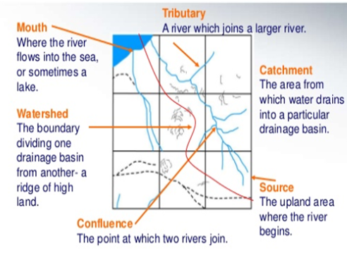

Slide 23
Subsurface (Ground) Water Resource of Ethiopia
As compared to surface water resources, Ethiopia has lower ground water potential.
However, there exists higher total exploitable groundwater potential.
Climatic and geophysical conditions determine the availability of groundwater resource.
Based on existing scanty knowledge, the groundwater potential of Ethiopia is estimated to be 2.6 - 6.5 BMC.
However, this estimate is now considered underestimated.
Considering various separate studies, Ethiopian potential of groundwater is believed to range between 12-30 BMC.

Slide 24
Water Resources Potentials and Development in Ethiopia
The enormous water resource potential of Ethiopia is underutilized due to so many factors.
However, there are plenteous of opportunities that can transform the resource into our collective social and economic needs.
The followings are some of potential development uses of water resource of Ethiopia.
a) Hydro-electric Potential
Ethiopian rivers have a very high potential for generating electricity.
The exploitable potential of hydroelectric power is estimated at about 45000 megawatts.

Slide 25
The first hydroelectric power generation plant was installed on Akaki River (Aba Samuel) in 1932.
Currently many hydroelectric power dams are operating and many others are under construction to realize Ethiopia's ambitious energy goals.
Grand Ethiopian Renaissance Dam (GERD) is the country's largest dam under construction aiming to generate 6400 megawatts.
Gilgel Gibe III hydropower project has gone operational generating 1870 megawatts.
Currently Ethiopia is administering 14 hydroelectric power plants constructed on Lake Aba Samuel, Koka, Tis Abay, Awash, Melka Wakena, Sor, Fincha, Gibe/Omo, Tana Beles and Tekeze, generating close to 4000 megawatts of energy.
Besides the domestic use of generated electricity, the country is exporting electricity to the neighboring countries.

Slide 26
The major problem related to the use of Ethiopian rivers for the generation of hydroelectric power is the seasonal flow fluctuations and impact of climate change and variability.
The severe erosion from the highlands and sedimentation in the reservoirs is also a critical problem for hydroelectric power generation.
b) Irrigation and Transportation
The terrain in Ethiopia is so rugged that it limits the uses of Ethiopian rivers both for irrigation and transportation.
In the highlands, steep slopes, rapids, waterfalls, narrow and deep valleys and gorges are important obstacles.
But on the lowlands, their demand for irrigation is high.
Regardless of existing physiographic setups, Ethiopia's potential of irrigation is estimated to be 5.3 million hectares.
The Baro-Akobo and Genale Dawa river systems have large irrigation potential compared to other basins.

Slide 27
Despite the untapped irrigation practice, more than 60% of the area under irrigation so far is located in Rift Valley Drainage System.
Except few, majority of hydro-electric reservoirs are multi-purpose and are expected to contribute for irrigation.
Majority of Ethiopian rivers are not suitable for transportation.
The Baro at its lower course is the only navigable river.
Comparatively, Ethiopian lakes are much suitable for transportation than rivers.
Lake Tana and Abaya are relatively the most used for transportation
c) Fishing and Recreation
The majority of Ethiopian lakes are rich in fish.
Currently the annual production of fish is estimated to be 31.5 thousand tons.
The exploitable potential is however, by far greater than the current production.
Exploitable fish potential in lakes varies.

Slide 28
Currently Lake Tana leads the potential by estimated 8,000-10,000 tons per year.
Fish production from Lake Chamo is estimated at 4,500 tons per year.
However, more than 60% of fish supplies are coming from Ethiopian main Rift Valley lakes.
However, some of the lakes are currently threatened by sedimentation, invasive species (water hyacinth), over exploitation and expansion of investments around lakes.
There are a variety of fish, birds and other aquatic life forms in the lakes.
This and the scenic beauty of the lakes, the hot springs around them, the spectacular river gorges and the most impressive waterfalls make Ethiopian rivers and lakes important recreational and tourist attractions.
As they are the natural habitat of a variety of wild life, some of which are only endemic to Ethiopia, their value for scientific purposes is immense.

Slide 29
.
THANK YOU!

